Slide 1
Innovation in Scholarly Communication: Impactful Practices for the Future
Stone Zhong
Manager, TrendMD China

Slide 2
Transforming the Landscape of Academic Publishing
The Revolution in Scholarly Publishing
From traditional models to dynamic, open, and tech-driven frameworks.
Driving Forces of Change
AI, open access, and digital platforms are accelerating knowledge dissemination.
Impact on Global Scholarship
Enhancing access, collaboration, and societal impact.

Slide 3
Latest Changes in the Publishing World
Open Access Increasing Accessibility Removing Barriers
+62%
Preprint Server Usage
2023: 170,000 preprints uploaded to arXiv
2013: 105,000 preprints uploaded to arXiv
Source: arXiv
+58%
Open Access Growth
2023: 15,000+ open access journals indexed by DOAJ
2013: 9,500 open access journals indexed by DOAJ
Source: DOAJ
Preprint Servers Faster Dissemination of Research Findings
Transformative Agreements Combining Subscription and Open Access

Slide 4
New Trends in Scholarly Communication
Plain Language: Making Science Accessible to a Broader Audience
AI Integration: Enhancing Manuscript Preparation and Peer Review
Data Sharing: Promoting Transparency and Reproducibility
+25%
Data Sharing Impact
Studies show that articles with shared data are cited 25% more than those without
Source: PLOS
+25%
AI in Publishing
The use of AI in publishing workflows is projected to grow by 25% annually
Source: Morressier, 2024

Slide 5
AI-powered Widget
We provide article recommendations within journals, blogs, and other sites that academics, doctors, and researchers use in their day-to-day work
Article abstract
widget

Slide 6
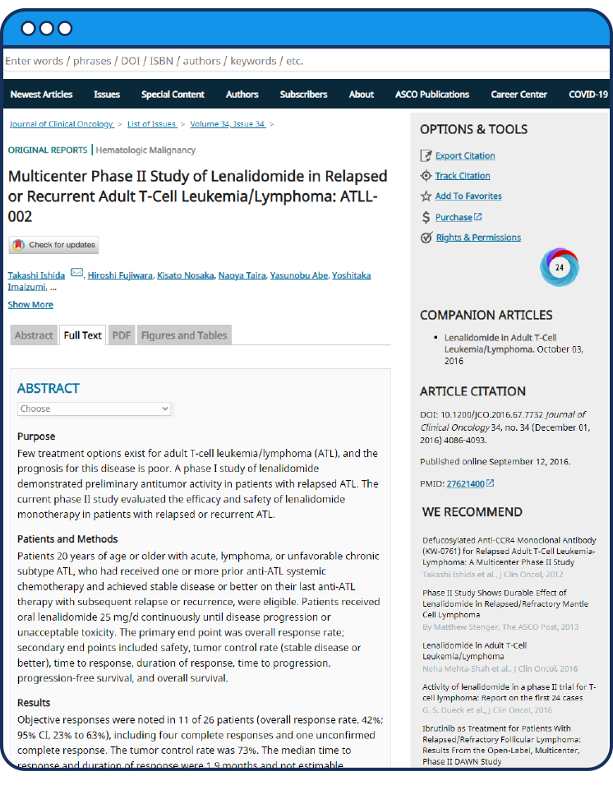
How it works
Readers discover new content, based on:
What they are reading
What other users like them have read
What they have read in the past

Slide 7
Publishers use TrendMD to maximize their growth
Grow your readership
Increase citations
Build brand awareness
Drive subscription revenue
Attract more authors
Drive conversions

Slide 8
TrendMD audience reach
5M+
Monthly Clicks
102M+
Monthly Unique Visit
60%
Desktop
40%
Mobile

Slide 9
Understand more about your audience: analytics
How many additional readers did TrendMD refer?
Which articles are generating and receiving the most traffic?
What journals are my readers coming from?
In which third-party journals is your content trending?
What country/region are my readers coming from?

Slide 10
Used on over 8,000 scholarly websites by 550+ publishers
Publishers
Integration partners

Slide 11
Impact on Authors
+70%
Altmetrics
70% of researchers use altmetrics to track the broader impact of their work
Source: Altmetric
Increased Control Over Published Work
Enhancing Visibility and Citation Impact
Author-Level Metrics and Altmetrics
+18%
Citation Impact
Open access articles receive 18% more citations than subscription-based articles
Source: PublishingState.com, 2023

Slide 12
Future Practices and Predictions
+60%
+30%
Social Media
60% of researchers use social media to share their findings and engage with peers
Source: ResearchGate
Peer Review
AI-assisted peer reviews reduce the average review time by 30%
Source: IntegraNXT, 2024
Evolution of Peer Review Processes
Role of Social Media in Scholarly Communication
Ethical Considerations and Challenges

Slide 13
Stone Zhong
stone.zhong@trendmd.com

